Slide 1
Final Project Presentation
<Q-CITY> - <Batch HYD-21> - <LG H95>
Presented by group-6

Slide 2
Objectives
Development Project
Requirement Analysis
Design
Construction
Defect Fixing
Software Testing
Importance of Software Testing
Verification and Validation
Software Test Lifecycle
Testing Process
Snapshots
Bug report
Folder hierarchy
CSV Report

Slide 3
DEVELOPMENT PROJECT
The most important task in the development phase is to build the application.
Contents of development phase-
Requirement analysis : Requirements analysis is the process of determining user expectations for a new or modified product.
Design :The Design phase is when you build the plan for how you will take your project through the rest of the SDL process—from implementation, to verification, to release.
Construction : in this phase we work on the construction part of project.
Defect fixing : defect are fixed in this.
- <number> -

Slide 4
Requirement Analysis (ETVX)
Entry Criteria:
Core banking case study documents Available
Standards and guidelines and template for SRS available
Tasks/Activities:
Analysis of Core banking requirement
Analyzing the problems and identifying requirements that would solve the stated problems.
Thorough reading and understanding of Core banking case study
Understanding and discussing the requirements of the customer
Allocating tasks to the team members according to their specialization
Verification/Validation:
IQA for SRS_banking v1.0
EQA for SRS_SIC v1.0
Tech lead verification
- <number> -

Slide 5
Exit Criteria:
SRS documents are prepared, verified and approved
Work Items/Deliverables:
SRS Document (banking_SRS User Management v1.0 Document )

Slide 6
Design (ETVX)
Entry Criteria:
SRS is available (Banking_SRS v1.0)
Standards, guidelines and templates for HLD,LLD phase are available.>
Tasks/Activities:
identifying actors,modules and other system components in the project
making the usecase diagrams for the identified actors
making the domain diagram
identifying classes and making the class diagram
understanding the flow of data and creating the sequence diagram for every usecase
preparing test cases for group 3 project
Preparation of HLD, LLD document.
Preparation of the first draft of STP(System Test Plan)
- <number> -

Slide 7
Verification/Validation:
Verification of STP ,HLD ,LLD by tech lead
Review database design
Exit Criteria:
use case ,domain ,class and sequence diagrams prepared ,test cases documents prepared, verified and approved
HLD ,LLD approved
Database Design approved
Work Items/Deliverables:
Design Document (banking_SDD v1.0)
System Test Cases (Banking Test Case Document v1.0)
Databases

Slide 8
Construction (ETVX)
Entry Criteria:
SDD documents are available
SRS and HLD documents are available.
Database design document is available.
Standards and guidelines for construction are available.
Tasks/Activities:
creating the main file
allocating usecase implementation through coding to various team members and
separately coding the usecases
integrating all the usecases coding
Unit testing and fixing of the detected errors.
- <number> -

Slide 9
Verification/Validation:
Verify IQA for banking v1.0
Verify EQA for SIC v1.0
code review by Tech lead
Exit Criteria:
Header files, libraries and executables prepared
Reviewed and unit tested code available
Work Items/Deliverables:
Updated SRS Document (banking SRS v1.0)
Unit tested Code

Slide 10
DEFECT FIXING
Prior to proceed for testing , defect in the project needs to be fixed
To fix these defects and verify that they have been fixed , the team completes these tasks:
1 : The development lead queries and determines for defects and assigns those defects to developers.
2 : Developers review their assigned defects, check in changes to fix the defects, run personal builds to test their changes, and deliver their changes to the stream. The release engineer then runs a team build to create a new version of the project that includes the fixes.

Slide 11

Software Testing
Testing is the process of analyzing a software item to detect the differences between existing and required conditions (that is defects/errors/bugs) and to evaluate the features of the software item.

Slide 12
IMPORTANCE
It helps reducing the bugs from the project.
Testing is about verifying that what was specified and what was Delivered so
it helps in correct delivery
A good testing program is a tool for both the agency and integrator/supplier.
It typically identifies the end of the “development” phase of the project.
it verifies that the product (system) meets the functional, performance,
design, and implementation requirements identified in the procurement specifications.

Slide 13
Software Test Lifecycle
There are several phases in Software Test Life Cycle. STLC is part of Software Development Life Cycle.
The phases are as follows :
1. Requirement Analysis/ System Study
2. Write Test Plan
3. Write Test Cases
Identify possible test scenarios
Write Test Cases
Review Test Cases
Fix Review Comments
Test Case Approval
Store in Repository
4. Traceability Matrix
5. Test Case Execution
6. Defect Tracking
7 Prepare Test Execution Report (TER) & Send it to the Customer
8. Retrospect Meeting

Slide 14
Testing Project
System Testing
Total number of test cases created : 89
Statistics :
Module to be tested | # of test cases | # of test cases failed / Defects | # of defects rejected by development team
UI | 30 | 10 | 0
Business Logic | 35 | 3 | 0
Database | 24 | 2 | 0
Other | 0 | 0 | 0

Slide 15
Verification & Validation
Tools used for V&V activity : Defect management tool used during PD phase is bugzilla
V&V activities performed :EQA(external quality assurance performed on group 3 project Sunidhi insurance company and IQA(internal quality assurance performed by project lead on our project q-city core banking
Sl # | V&V Type (IQA, EQA, FI) | Configurable Item | # of defects or review comments | Severity-wise statistics
1 | EQA | SIC_SRS V1.0 | 3 | Severity 1: 2 Severity 2: 5 Severity 3: 5 Severity 4: 3
2
3
- <number> -

Slide 16
Configuration Management
Configuration Management Tool : Bugzilla
List of deliverables/configurable items : SRS ,SDD
Sl # | Deliverables/ Configurable Items | Path (SVN/TFS/CVS)
1 | Core banking SRS v1.0 | </usr/local/cvs/H95/H95_group6/banking/Folderhierarchy/deliverables/>
2 | Core banking SDD v1.0 | </usr/local/cvs/H95/H95_group6/banking/Folderhierarchy/deliverables/>
3 | Traceability matrix v1.0 | </usr/local/cvs/H95/H95_group6/banking/Folderhierarchy/deliverables/>
4 | Project log | </usr/local/cvs/H95/H95_group6/banking/Folderhierarchy/deliverables/>
5 | Test case document | </usr/local/cvs/H95/H95_group6/banking/Folderhierarchy/deliverables/>

Slide 17
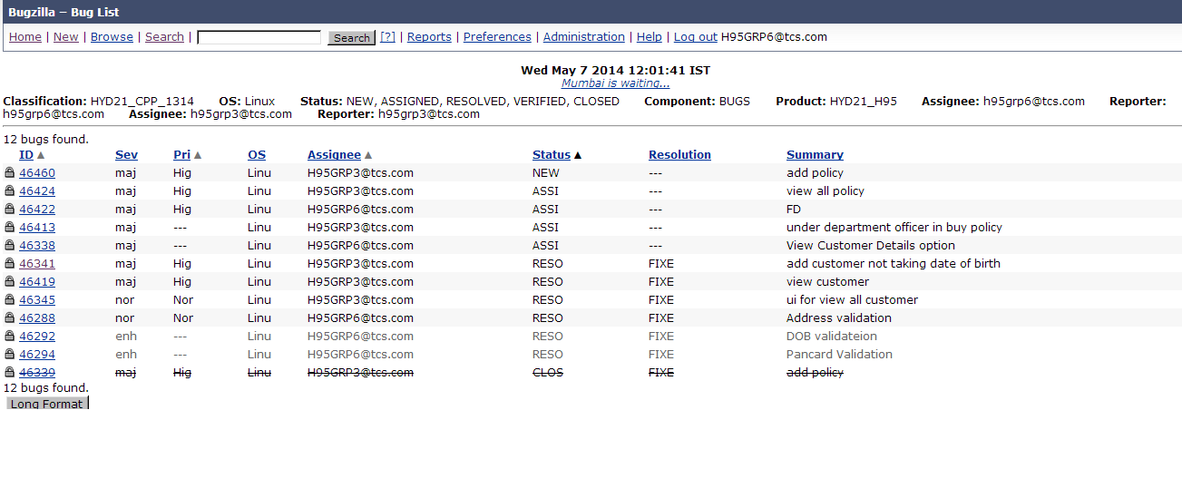
SNAPSHOTS
BUG REPORT

Slide 18
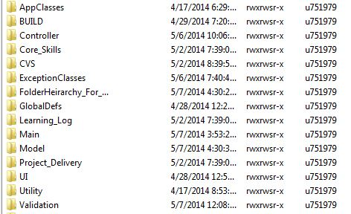
SNAPSHOTS
FOLDER HIERARCHY

Slide 19
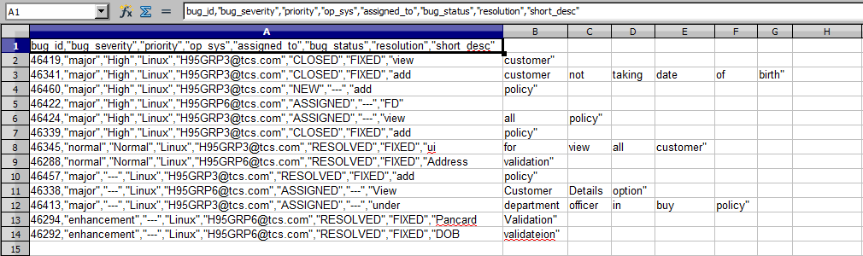
CVS REPORT

Slide 20
Thank You

